Slide 1
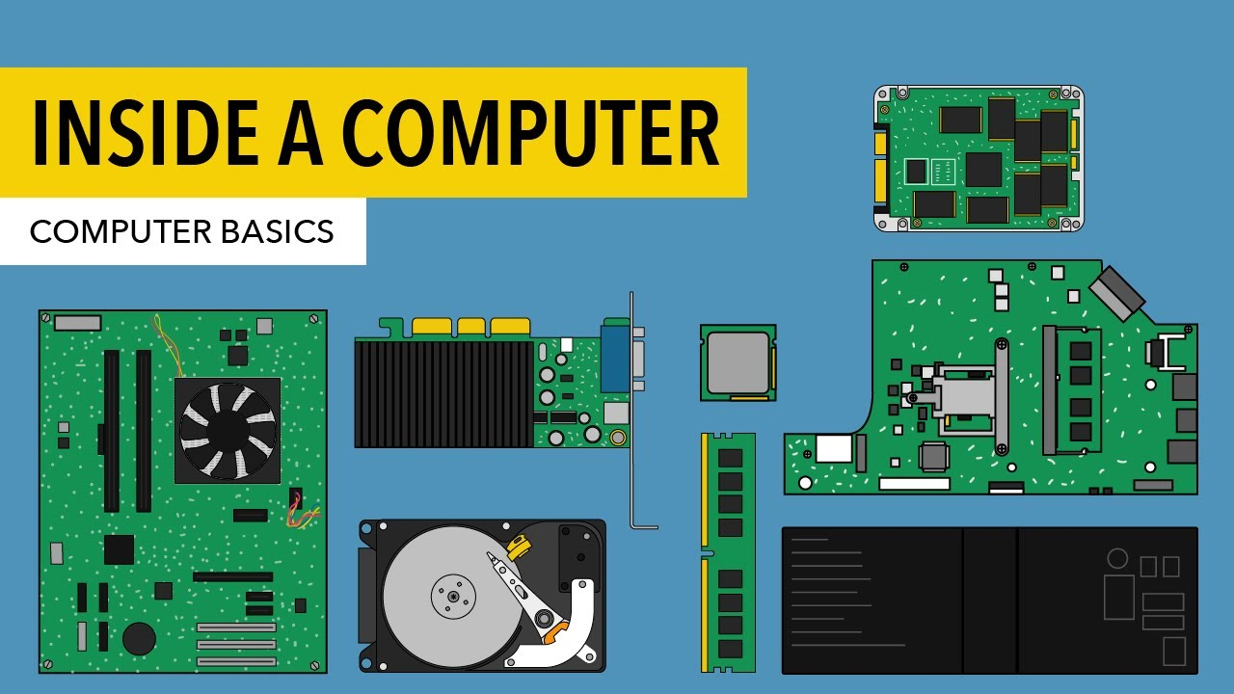
Computer Organization and Architecture

Slide 2
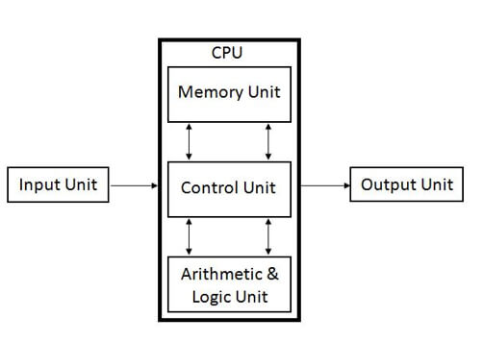
Computer Organization and Architecture

Slide 3
The Five Classic Components of a Computer
Input (mouse, keyboard, …)
Output (display, printer, …)
Memory
main (DRAM), cache (SRAM)
secondary (disk,
CD, DVD, …)
Datapath
Control
Input
Output
Processor
(CPU)
Processor
Control
Memory
1001010010110000
0010100101010001
Datapath
1111011101100110
1001010010110000
1001010010110000
1001010010110000

Slide 4
PREREQUISITES
1. BASIC CONCEPT IN DIGITAL CIRCUIT.
2. FAMILIRITY WITH PROGRAMMING LANGAUGE.-C, C++
Books
1. Computer Organization and Architecture: Designing for Performance by William Stalling.
2. Computer System Architecture” by M. Morris Mano.

Slide 5
Course objectives
The students will learn,
1. How the computer system works & its basic principles.
2. Instruction level architecture.
3. Instruction level parallelism and knowledge on micro programming.
4. Memory organization, I/O organization and how they are accessed.

Slide 6
Course outcome
At the end of Course students will be able to
CO1 Describe the fundamental organization of a computer system.
CO2 Describe various addressing modes, Instruction types and execution of the instructions.
CO3 Explain representation of Integer and Floating Point and their arithmetic.
CO4 Explain Memory Organization.
CO5 Explain I/O and Describe the basics of hardwired and micro-
programmed control of the CPU, pipelined architecture.

Slide 7
Computer Organization and Architecture
CA Methodologies:
CA I : Quiz (Based on Unit 1, Unit 2, Unit3)
CA II : Assignment(Based on Unit 3, Unit 4, Unit 5)

Slide 8
Computer Organization and Architecture
Unit 1-Introduction : Concept of computer organization and architecture, Fundamental unit, Computer function and interconnection, CPU structure and function.
Unit 2-Instruction Sets : Characteristics, Types of operands, Types of operations, Assembly language, Addressing modes, Instruction format, Types of instruction, Instruction execution, Machine state and processor status, Structure of program, Introduction to RISC and CISC architecture.
Unit 3-Computer Arithmetic: The arithmetic and logic Unit, Integer representation, Integer arithmetic, Floating point representation, Floating point arithmetic, Introduction of arithmetic co-processor.

Slide 9
Computer Organization and Architecture
Unit 4-Memory Organization : Internal Memory: Semiconductor main memory, Error correction, Advanced DRAM organization, Virtual memory systems and cache memory systems. External Memory: Organization and characteristics of magnetic disk, Magnetic tape, Optical memory, RAID, Memory controllers.
Unit 5-Control Unit and Input / Output Organization: Control unit operation: Micro-operations, Control of the processor, Hardwired implementation, Micro- programmed Control Unit, Basic concepts, Micro-instruction sequencing, Micro-instruction execution, Applications of micro-programming. Input/output Organization: External devices, I/O module, Programmed I/O, Interrupt driven I/O, Direct memory access, I/O channels and processors, External interface. Instruction pipe-lining: Concepts. Parallel processing: Multiple processor organization, Symmetric multiprocessor, Cache coherence and the MESI protocol.

Slide 10

Computer organization and Architecture PREREQUISITES
Binary Number System & its arithmetic.
Digital Logics.
Logic Gates.
One bit Memory Cell.

Slide 11
1. Number System
Number Systems
a. Decimal 10 0,1,2,3,4,5,6,7,8,9
b. Octal 8 0,1,2,3,4,5,6,7
c. Hexa-Decimal 16 0,1,…8,9,A,B,C,D,E,F
d. Binary 2 0,1

Slide 12
1. Binary Number & it’s arithmetic's
Binary:-
0 and 1 ( Data, Control word….Everything flowing inside computers wire and in memory)
Binary Arithmetic:-
a. Addition
b. Subtraction
c. Multiplication
d. Division

Slide 13
1. Binary Number & it’s arithmetic's
Binary representation How to calculate Binary no. value
2 Bit |  | 3 Bit
Decimal | Binary | Decimal | Binary
0 | 00 | 0 | 000
1 | 01 | 1 | 001
2 | 10 | 2 | 010
3 | 11 | 3 | 011
 |  | 4 | 100
 |  | 5 | 101
 |  | 6 | 110
 |  | 7 | 111
8 4 2 1 | Value
1 0 1 0 | 10
0 1 | 1
1 1 | 3
0 1 1 1 | 7
1 1 1 1 | 15
1 0 0 0 | 8
0 1 1 0 | 6

Slide 14
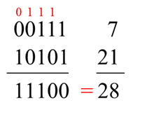
1. Binary Number & it’s arithmetic's
Addition
0 + 0 = 0
0 + 1 = 1
1 + 0 = 1
1 + 1 = 10 (which is 0, carry 1)

Slide 15
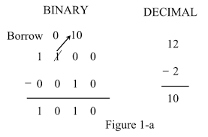
1. Binary Number & it’s arithmetic's
Subtraction
0 - 0 = 0
0 - 1 = 1 ( Borrow- 1)
1 - 0 = 1
1 - 1 = 0

Slide 16
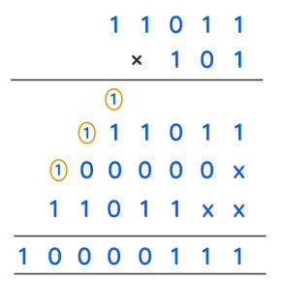
1. Binary Number & it’s arithmetic's
Multiplication

Slide 17
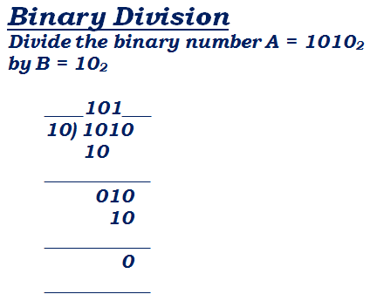
1. Binary Number & it’s arithmetic's
Division

Slide 18
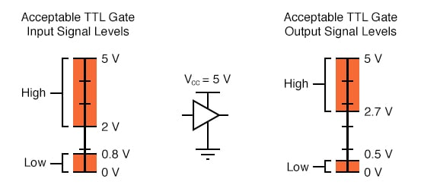
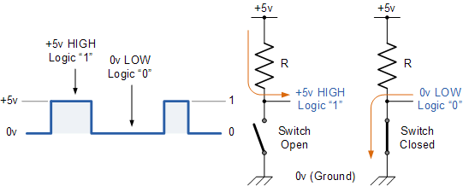
2. Digital Logic
Actual Electrical Level

Slide 19
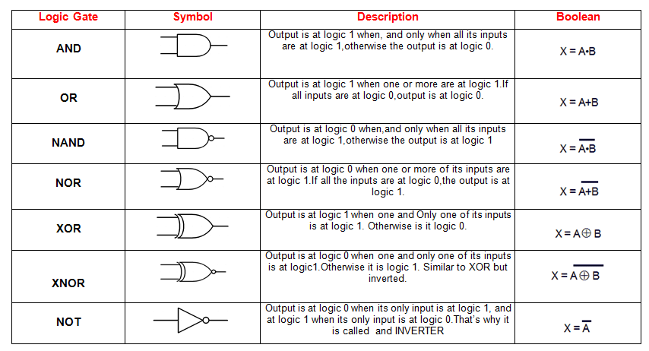
3. Digital Logic
.
Logic Gates

Slide 20
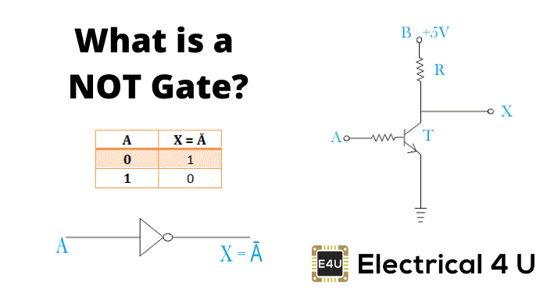
3. Digital Logic
.
Inside Logic Gates

Slide 21
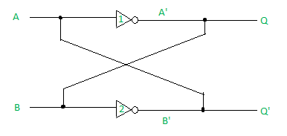
4. One bit Memory Cell

Slide 22
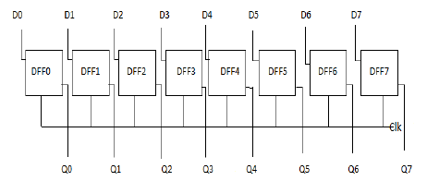
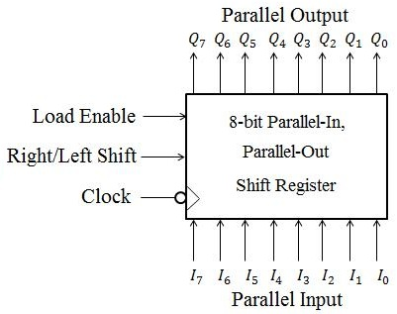
Register ( 8 Bit)

Slide 23

Concept of computer organization and architecture
The architecture of a computer system can be considered as a catalogue of tools or attributes that are visible to the user such as instruction sets, number of bits used for data, addressing techniques, etc. i.e.
Computer Architecture refers to those attributes of a system that have a direct impact on the logical execution of a program.
Examples: The instruction set
The number of bits used to represent various data types I/O mechanisms
memory addressing techniques

Slide 24
Concept of computer organization and architecture
Organization of a computer system defines the way system is structured so that all those catalogued tools can be used. The significant components of Computer organization are ALU, CPU, memory and memory organization.
Computer Organization refers to the operational units and their interconnections that realize the architectural specifications.
Example:
Control signals
Interfaces between computer and peripherals
The memory technology being used

Slide 25
Concept of computer organization and architecture
Lets be clear,
The fact that a multiply instruction is available is a computer architecture issue. How that multiply is implemented is a computer organization issue.
• Architecture is those attributes visible to the programmer such as Instruction set, number of bits used for data representation, I/O mechanisms, addressing techniques. e.g. Is there a multiply instruction?
• Organization is how features are implemented o Control signals, interfaces, memory technology. e.g. Is there a hardware multiply unit or is it done by repeated addition?

Slide 26
difference between computer organization and architecture
Computer Architecture | Computer Organization
Architecture involves Logic (Instruction sets, Addressing modes, Data types, Cache optimization) | Organization involves Physical Components (Circuit design, Adders, Signals, Peripherals)
Computer Architecture deals with high-level design issues. | Computer Organization deals with low-level design issues.
Computer Architecture helps us to understand the functionalities of a system. | Computer Organization tells us how exactly all the units in the system are arranged and interconnected.
While designing a computer system architecture is considered first. | An organization is done on the basis of architecture.

Slide 27
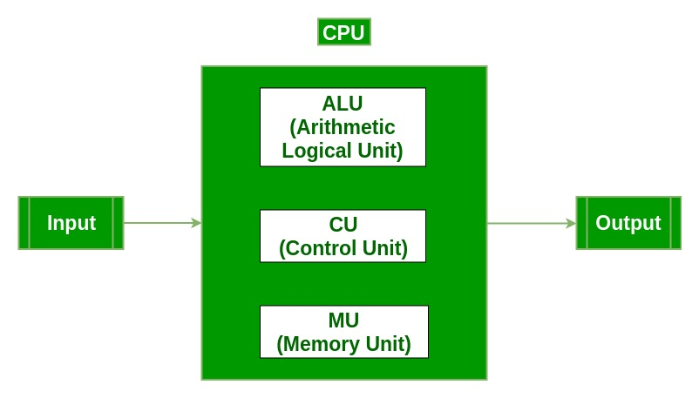
Fundamental units

Slide 28
Interconnection between Functional Components

Slide 29
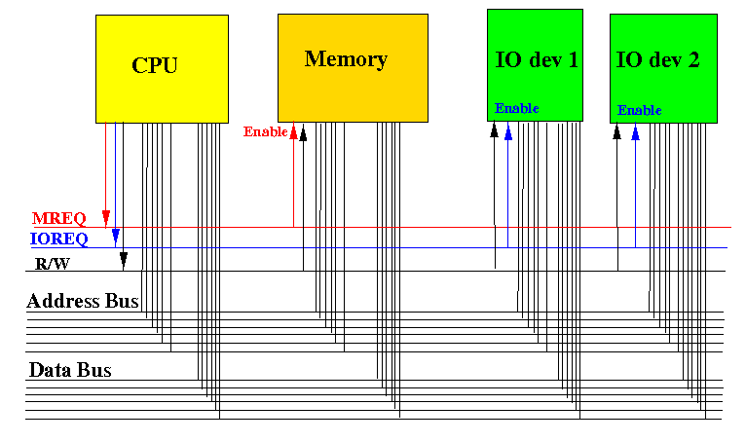
Interconnection between Functional Components

Slide 30
Interconnection between Functional Components

Slide 31
Interconnection between Functional Components

Slide 32
CPU structure and function Structure is the way in which components relate to each other Function is the operation of individual components as part of the structure

Slide 33
CPU structure and function- All Processor

Slide 34
CPU structure and function- All Processor

Slide 35
CPU structure and function- All Processor

Slide 36
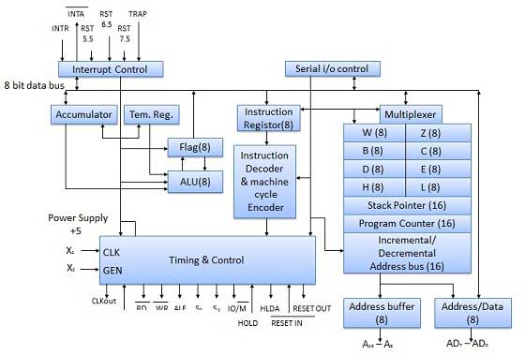
CPU structure and function-8085 Processor

Slide 37
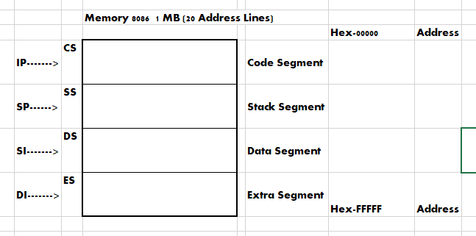
memory segmentation in 8086 memory

Slide 38
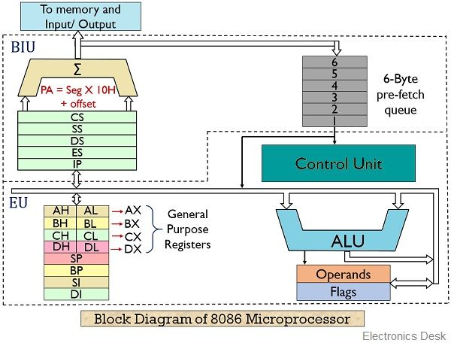
CPU structure and function-8086 Processor

